Slide 1
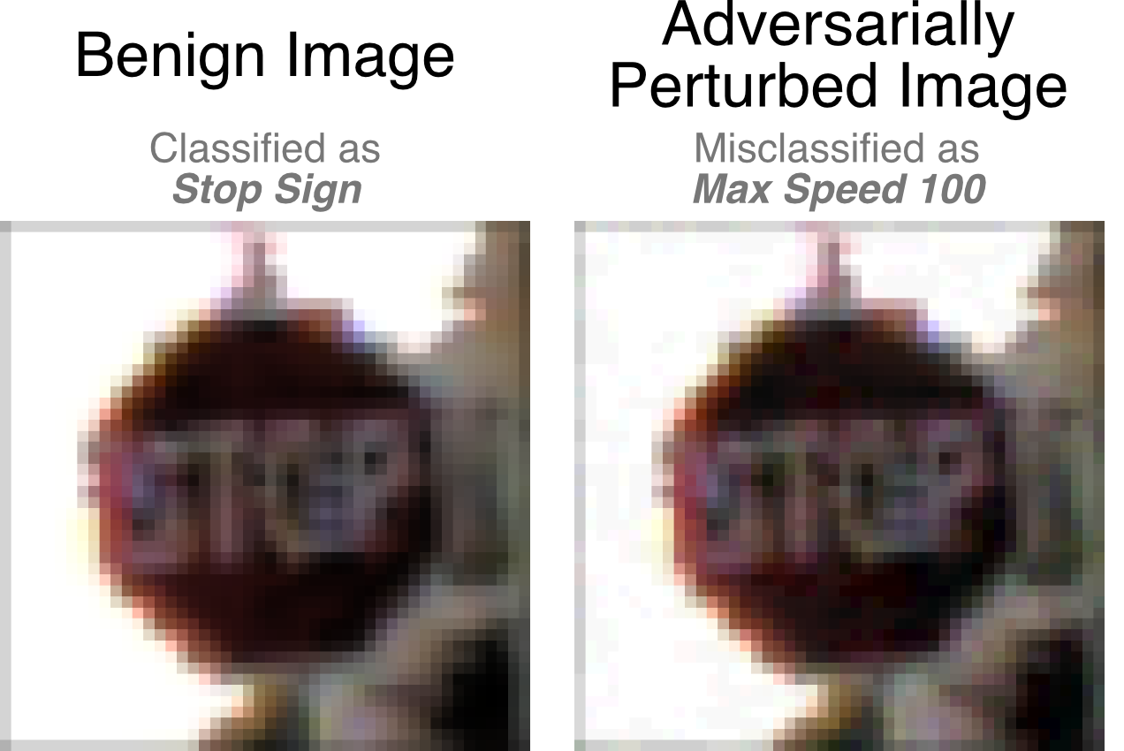
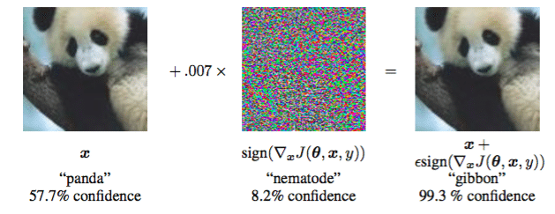
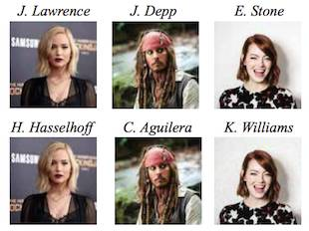
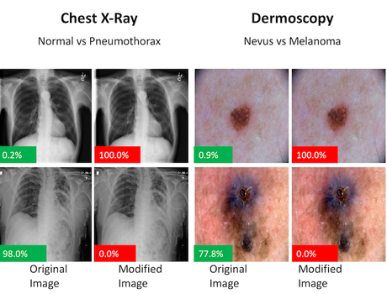
Provable Defenses against Adversarial Examples via the Convex Outer Adversarial Polytope
Eric Wong, J. Zico Kolter
ICML 2018
Sungyoon Lee
Statistical Learning & Computational Finance Lab
Department of Mathematical Sciences
Seoul National University
Notes:
딥러닝은 뛰어난 성능을 보여주나 input에 작은 noise를 주어 잘못된 판단을 하도록 하는 adversarial attack이 가능함이 알려져 있다. 이러한 문제점은 자율주행자동차, 얼굴인식, 의료 분야로의 적용을 저해하는 요인이 된다.

Slide 2
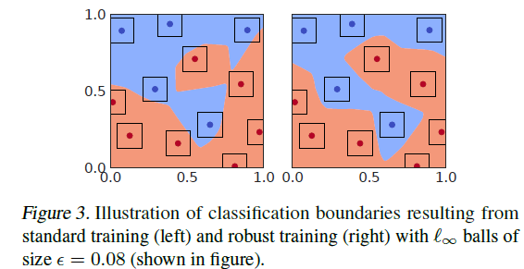
problem statements
GOAL) ReLU based deep classifiers that are guaranteed to be robust against any norm-bounded adversarial perturbations
GOAL!
Notes:
이 논문에서는 ReLU based deep classifer로 한정시켜 norm bounded된 adversarial perturbation에 robust한 classifier를 학습시키는 방법을 제안한다.
아래 그림과 같이 norm ball이 decision boundar바깥으로 나가지 않고 본래와 같은 class로 판단하도록 하길 바란다.

Slide 3
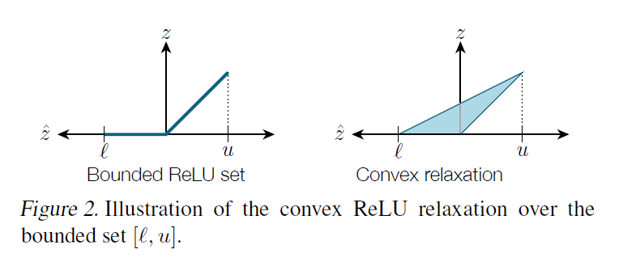
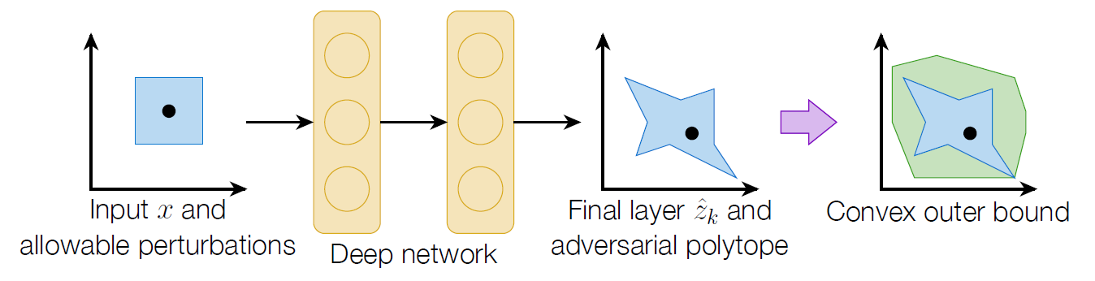
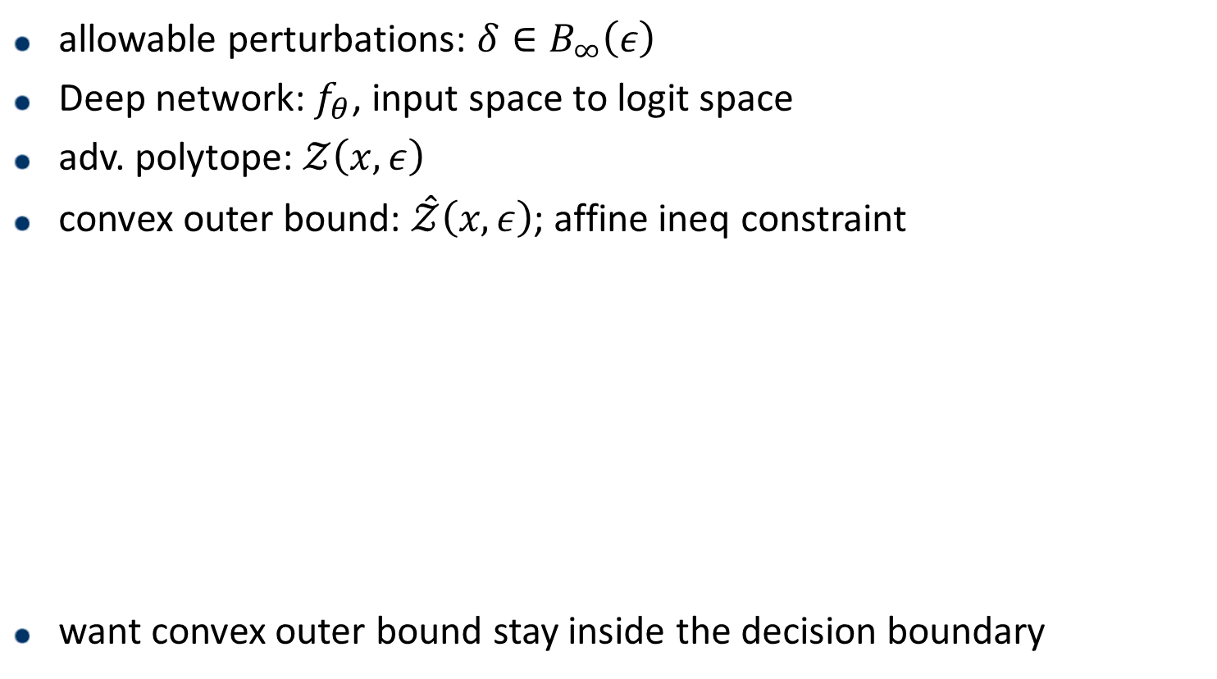
Illustrations
allowable perturbations: $δ∈B_{∞}\left(ε\right)$
Deep network: $f_{θ}$, input space to logit space
adv. polytope: $𝒵\left(x,ε\right)$
convex outer bound: $\hat{𝒵}\left(x,ε\right)$; affine ineq constraint
want convex outer bound stay inside the decision boundary
Notes:
다음과 같이 norm ball의 deep learning network를 통한 image를 adversarial polytope라 하고 이를 적당히 tight하게 포함하는 convex outer bound를 생각하자.
이때 cvx outer bound는 relu의 relaxation을 통한 image로 얻어지고 convex하고 affine ineq constraint를 만족하는 set이 된다. 따라서 objective function이 linear하게 되면 LP문제를 얻을 수 있다.

Slide 4
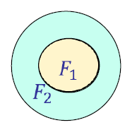
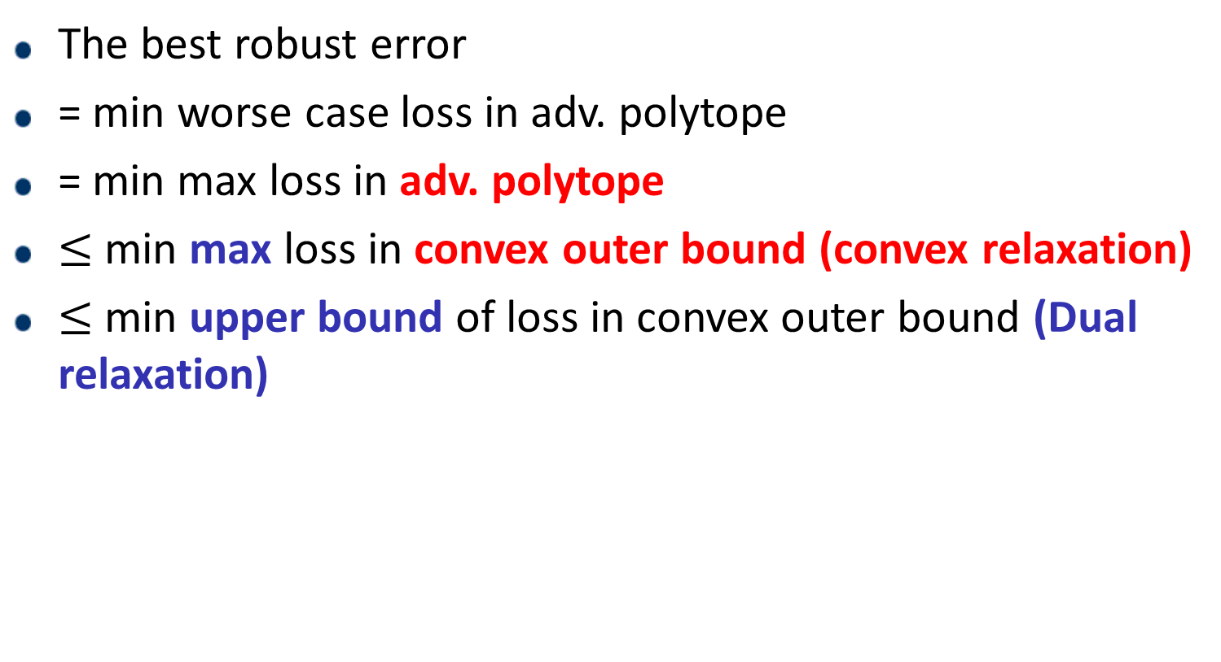


Scheme
The best robust error
= min worse case loss in adv. polytope
= min max loss in adv. polytope
$≤$min max loss in convex outer bound (convex relaxation)
$≤$ min upper bound of loss in convex outer bound (Dual relaxation)
$$F_{1}$$
$$F_{2}$$
Notes:
전체적인 scheme은 다음과 같다. 최적의 robust error를 얻기 위해, 최악의 loss를 minimize하고자 한다.
이때 adversarial polytope안에서 생각하는 대신 convex outer bound를 생각하면 그 값은 더 커지게 되고, 이때 한번의 relaxation이 생긴다.
또한 inner maximization을 계산할 때, dual문제를 고려하여 upper bound만을 얻어 이를 minimize한다면 어느정도는 best robust error를 얻을 수 있게 될것으로 기대하는 것이다.

Slide 5
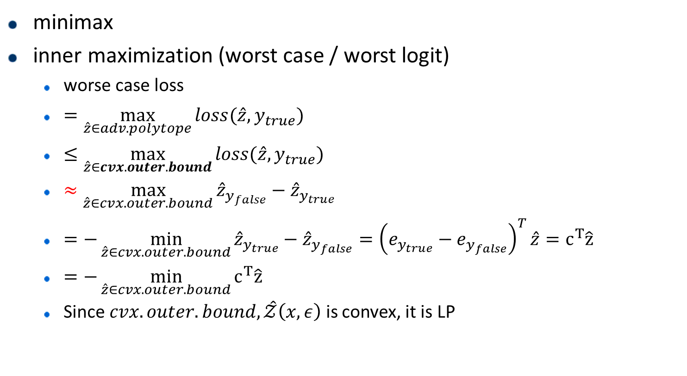
optimization formulation – LP relaxation
minimax
inner maximization (worst case / worst logit)
worse case loss
$=\max_{\hat{z}∈adv.polytope}{loss(\hat{z}, y_{true})}$
$≤\max_{\hat{z}∈cvx.outer.bound}{loss(\hat{z}, y_{true})}$
$≈\max_{\hat{z}∈cvx.outer.bound}{{\hat{z}}_{y_{false}}−{\hat{z}}_{y_{true}}}$
$=−\min_{\hat{z}∈cvx.outer.bound}{{\hat{z}}_{y_{true}}−{\hat{z}}_{y_{false}}}={\left(e_{y_{true}}−e_{y_{false}}\right)}^{T}\hat{z}=c^{T}\hat{z}$
$=−\min_{\hat{z}∈cvx.outer.bound}{c^{T}\hat{z}}$
Since $cvx.outer.bound, \hat{𝒵}\left(x,ε\right)$ is convex, it is LP
Notes:
자세한 식으로 나타내자면 loss를 다음과 같이 logit의 차이로 본다면 linear objective를 얻을 수 있어 LP문제가 된다.

Slide 6
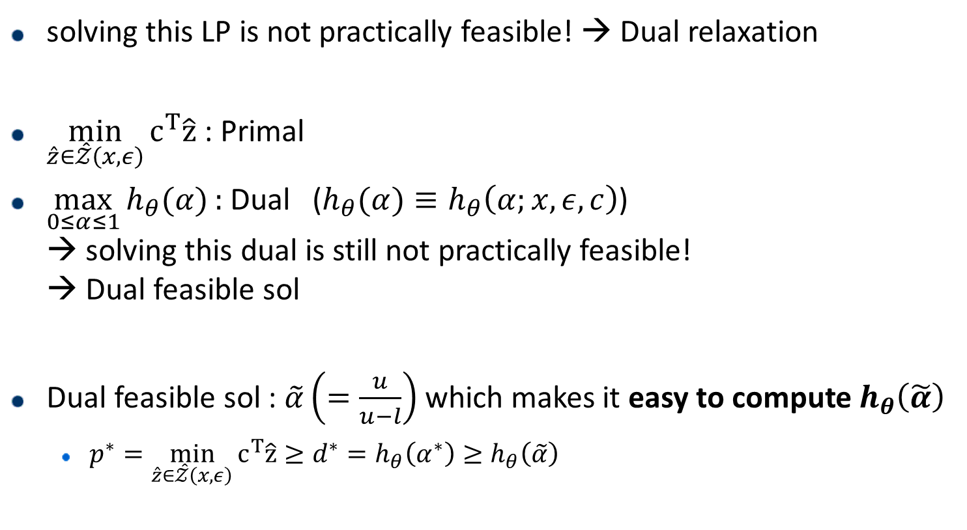
Dual relaxation
solving this LP is not practically feasible! → Dual relaxation
$\min_{\hat{z}∈\hat{𝒵}\left(x,ε\right)}{c^{T}\hat{z}}$ : Primal
$\max_{0≤α≤1}{h_{θ}(α)}:$ Dual ($h_{θ}(α)≡h_{θ}\left(α;x,ε, c\right)$) → solving this dual is still not practically feasible! → Dual feasible sol
Dual feasible sol : $\tilde{α}\left(=\frac{u}{u−l}\right)$ which makes it easy to compute $h_{θ}\left(\tilde{α}\right)$
$p^{∗}=\min_{\hat{z}∈\hat{𝒵}\left(x,ε\right)}{c^{T}\hat{z}}≥d^{∗}=h_{θ}\left(α^{∗}\right)≥h_{θ}\left(\tilde{α}\right)$
Notes:
그러나 이러한 LP문제를 training sample x들에 대해서 반복적으로 풀어주는 것은 실제 training과정을 생각하면 계산적으로 불가능한 일이다.
따라서 LP문제를 직접 푸는 대신 dual feasible solution을 구하는 것으로 대체하고 이때 dual feasibel solution은 dual값의 계산이 간단하도록 선택한다.
추가적으로 논문에서는 이 값이 적당히 괜찮은 값임을 말해준다.

Slide 7
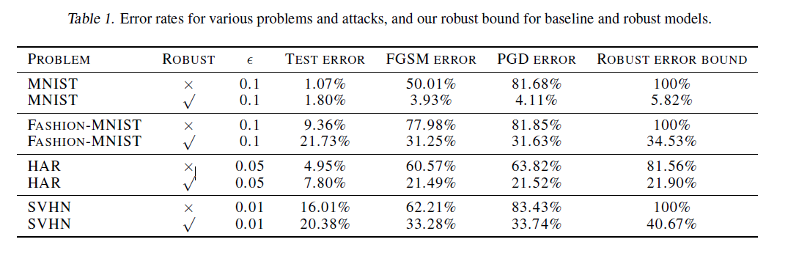

Final form / the results
$\min_{θ}{\max_{\hat{z}∈𝒵\left(x,ε\right)}{c^{T}\hat{z}}}$
$≤\min_{θ}{\max_{\hat{z}∈\hat{𝒵}\left(x,ε\right)}{c^{T}\hat{z}}}$
$=−\min_{θ}{\min_{\hat{z}∈\hat{𝒵}\left(x,ε\right)}{c^{T}\hat{z}}}$
$≤\min_{θ}\left(−h_{θ}\left(\tilde{α}\right)\right)$
$θ$is updated by gradient descent that decrease $−h_{θ}$
convex relaxation
Dual relaxation
worst case
Notes:
전체적인 과정은 다음과같이 adv polytope대신 convex outer bound를 쓰는 convex relaxation과정과
dual feasible solution을 사용하는 dual relaxation 과정으로 나눌 수 있다.
결과적으로 MNIST의 경우 robust error = 5.82를 얻을 수 있고, PGD attack을 상정하였을 때 4.11%의 error를 보여주었다.

Slide 8

A message to home
not convex → ‘convex relaxation’
not easy → ‘dual relaxation’ (a dual feasible solution)
Notes:
결론적으로 우리는 정확한 값을 얻기를 바라는 opt문제가 아닌 경우 근사를 통해 진행하는 것이 필요하고 특히 계산량이 더 큰 문제인 경우 적당한 근사방법이 매우 중요함을 알 수 있었다.
따라서 convex relaxation과 dual relaxation을 통해 본 문제 뿐만 아니라 다른 공학적 문제 또한 해결할 수 있을 것으로 생각된다.

Slide 9

The details are overly simplified (or wrong, $≈$)
for the brief presentation.
Thank you
Notes:
실제로 완벽하게 논문과 동일한 내용은 아니다. 뒤의 appendix에 나와있는 Thm2를 참고하길 바란다. 또한 l,u를 계산하는 알고리즘은 논문을 참고하길 바란다.

Slide 10
Introduction – Adversarial attack
Notes:
adv attac은 작은 노이즈를 주어 deep learning network를 틀리게 하는 것입니다.
자율주행, 얼굴인식, 의료 등의 보안이 중요한 분야에 딥러닝을 사용하기 위해서는 이러한 attac에 robust한 classifier가 필요합니다.

Slide 11
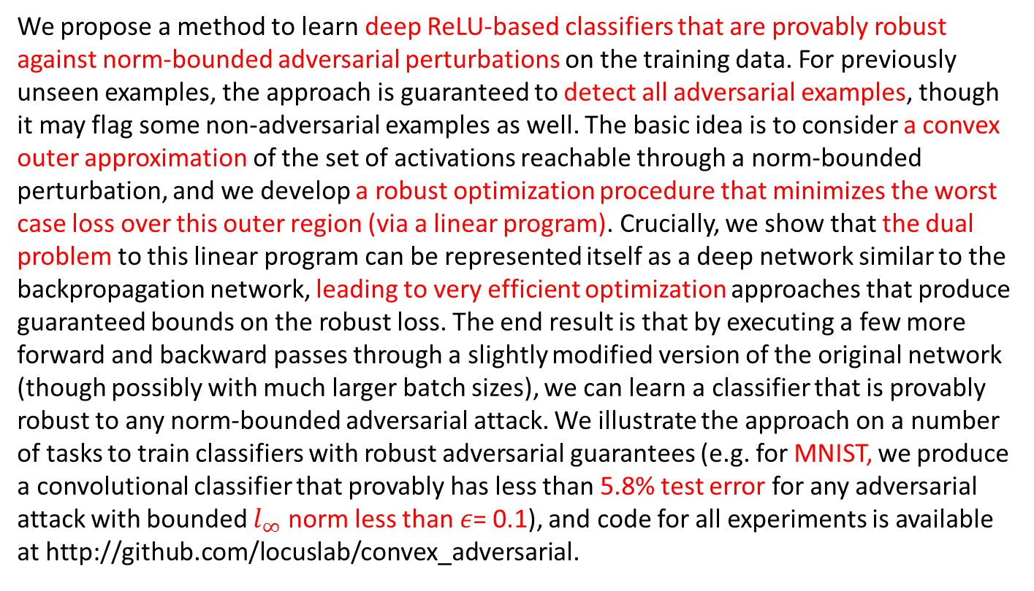
Abstract
We propose a method to learn deep ReLU-based classifiers that are provably robust against norm-bounded adversarial perturbations on the training data. For previously unseen examples, the approach is guaranteed to detect all adversarial examples, though it may flag some non-adversarial examples as well. The basic idea is to consider a convex outer approximation of the set of activations reachable through a norm-bounded perturbation, and we develop a robust optimization procedure that minimizes the worst case loss over this outer region (via a linear program). Crucially, we show that the dual problem to this linear program can be represented itself as a deep network similar to the backpropagation network, leading to very efficient optimization approaches that produce guaranteed bounds on the robust loss. The end result is that by executing a few more forward and backward passes through a slightly modified version of the original network (though possibly with much larger batch sizes), we can learn a classifier that is provably robust to any norm-bounded adversarial attack. We illustrate the approach on a number of tasks to train classifiers with robust adversarial guarantees (e.g. for MNIST, we produce a convolutional classifier that provably has less than 5.8% test error for any adversarial attack with bounded $l_{∞}$ norm less than 𝜖= 0.1), and code for all experiments is available at http://github.com/locuslab/convex_adversarial.

Slide 12
Contents
ReLU-based
provably robust against norm-bounded adversarial perturbations
a convex outer approximation
robust optimization
Linear programming
dual problem

Slide 13
Introduction - History
Prevalence of adversarial examples(Szegedy et al., 2014; Goodfellow et al., 2015)
Distillation(Papernot et al., 2016) → broken by (Carlini & Wagner, 2017b)
No need to worry about adversarial attack under realistic settings (Lu et al., 2017) → EOT (Athalye & Sutskever, 2017)
Lacks of full knowledge of the model doesn’t appear to be a problem = ‘black-box’ attack (Papernot et al., 2017)
Many of papers at ICLR 2018 were broken (Athalye et al., 2018)

Slide 14
Introduction - Goal
Focus) ReLU classifiers that are guaranteed to be robust against any norm-bounded adversarial perturbations
+) detecting adversarial perturbations with zero false negatives

Slide 15
Introduction - Goal
Attackers are the “winners” of this current game
Want) classifiers that are guaranteed to be robust to adversarial attacks even under the ‘white-box’ attack

Slide 16

Illustrations (worst case loss)
allowable perturbations: $δ∈B_{∞}\left(ε\right)$
Deep network: $f_{θ}:R^{\left|x\right|}→R^{\left|y\right|}$ : input space to logit space
adv. polytope: ${\hat{z}}_{k}∈𝒵\left(x,ε\right)$
convex outer bound: ${\hat{z}}_{k}∈\hat{𝒵}\left(x,ε\right)$
Notes:
adv polytope가 decision boundary를 벗어나지 않기를 원함

Slide 17
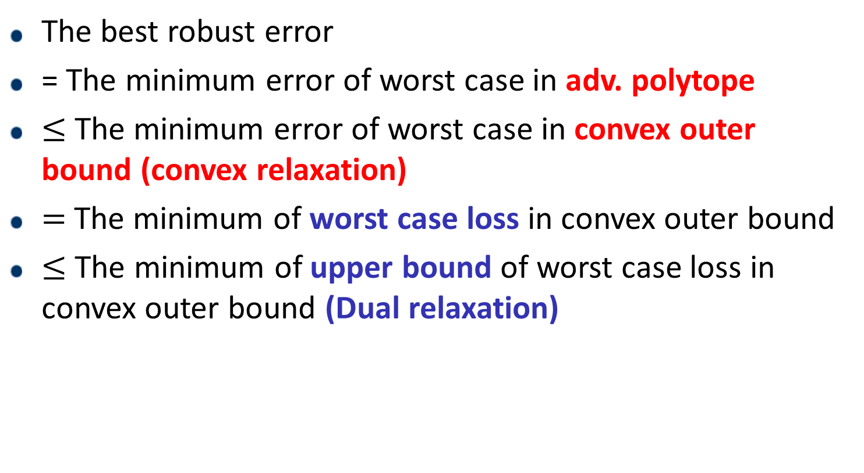
Scheme
The best robust error
= The minimum error of worst case in adv. polytope
$≤$The minimum error of worst case in convex outer bound (convex relaxation)
$=$The minimum of worst case loss in convex outer bound
$≤$ The minimum of upper bound of worst case loss in convex outer bound (Dual relaxation)

Slide 18
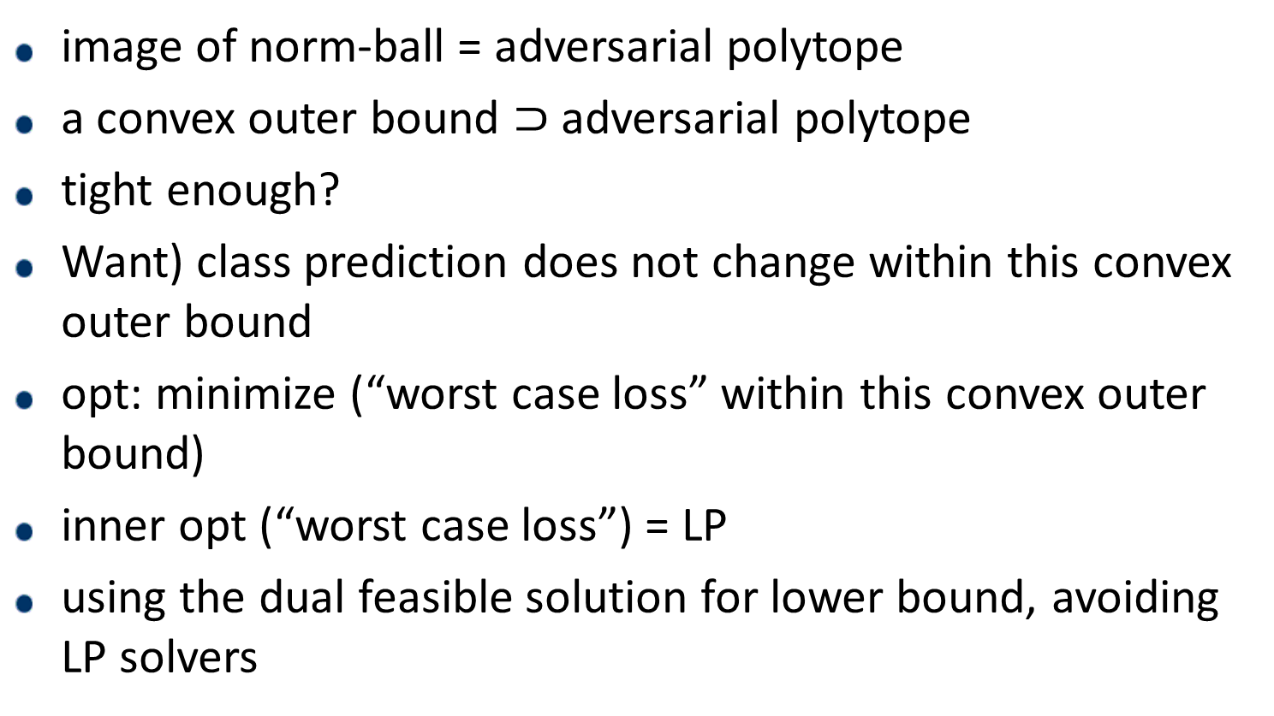
main
image of norm-ball = adversarial polytope
a convex outer bound $⊃$ adversarial polytope
tight enough?
Want) class prediction does not change within this convex outer bound
opt: minimize (“worst case loss” within this convex outer bound)
inner opt (“worst case loss”) = LP
using the dual feasible solution for lower bound, avoiding LP solvers

Slide 19
main
A ReLU transform image of convex set may not be convex
affine transform
ReLU
transform

Slide 20

LP relaxation
$z_{i}=ReLU\left({\hat{z}}_{i}\right)=max⁡({\hat{z}}_{i},0)$
$z_{i}∈{ReLU}_{relax}\left({\hat{z}}_{i}\right)=\{z≥0, z≥\hat{z}, z≤line_{l,u}\left(\hat{z}\right)\}$
where $l, u$is lower and upper bounds for the pre-ReLU activation ${\hat{z}}_{i}$

Slide 21

optimization formulation
$\min_{θ}{𝔼[\underset{δ∈B_{∞}\left(ε\right)}{worst_case_loss}{ (x+δ, y_{true})}}]$
$=\min_{θ}{𝔼[\underset{\hat{z}∈𝒵\left(x,ε\right)}{worst_case_loss}{ (\hat{z},y_{true})}}]$
$≤\min_{θ}{𝔼[\underset{\hat{z}∈\hat{𝒵}\left(x,ε\right)}{worst_case_loss}{ (\hat{z},y_{true})}}]$

Slide 22
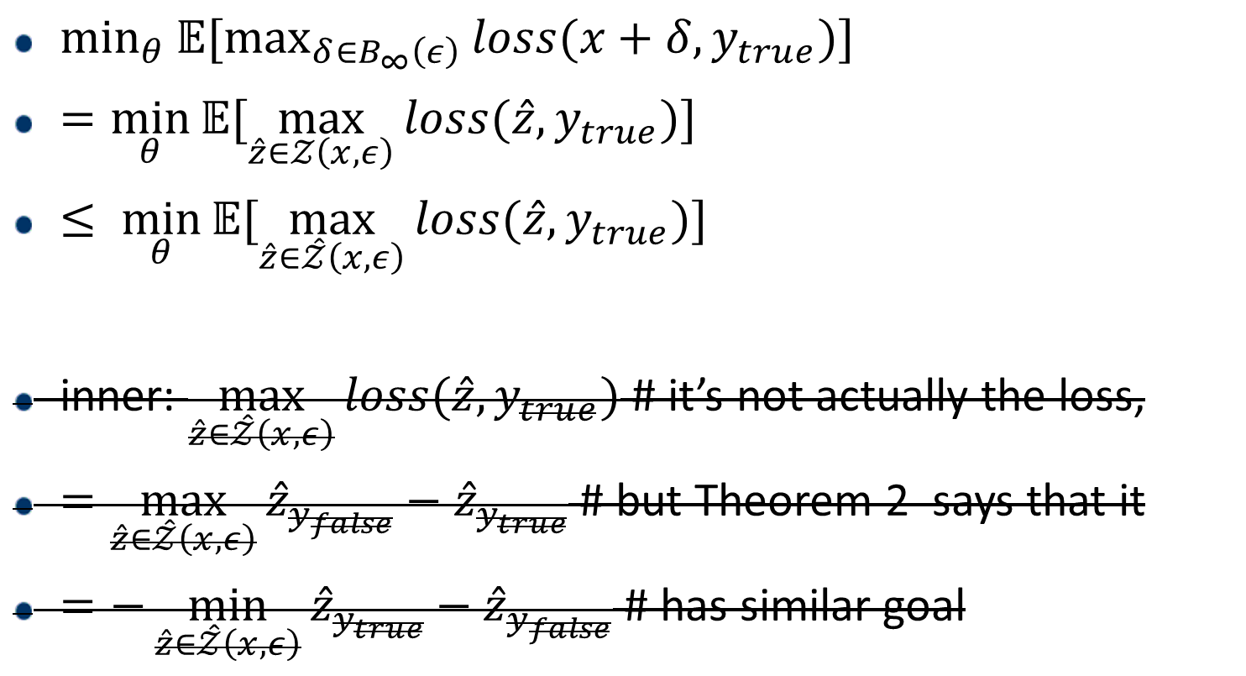
optimization formulation
$\min_{θ}{𝔼[\max_{δ∈B_{∞}\left(ε\right)}{loss(x+δ, y_{true})}}]$
$=\min_{θ}{𝔼[\max_{\hat{z}∈𝒵\left(x,ε\right)}{loss(\hat{z}, y_{true})}}]$
$≤ \min_{θ}{𝔼[\max_{\hat{z}∈\hat{𝒵}\left(x,ε\right)}{loss(\hat{z}, y_{true})}}]$
inner: $\max_{\hat{z}∈\hat{𝒵}\left(x,ε\right)}{loss(\hat{z}, y_{true})}$ # it’s not actually the loss,
$=\max_{\hat{z}∈\hat{𝒵}\left(x,ε\right)}{{\hat{z}}_{y_{false}}−{\hat{z}}_{y_{true}}}$ # but Theorem 2 says that it
$=−\min_{\hat{z}∈\hat{𝒵}\left(x,ε\right)}{{\hat{z}}_{y_{true}}−{\hat{z}}_{y_{false}}}$ # has similar goal

Slide 23

optimization formulation
inner: $\max_{\hat{z}∈\hat{𝒵}\left(x,ε\right)}{loss(\hat{z}, y_{true})}$
Instead, we will consider following
$\max_{\hat{z}∈\hat{𝒵}\left(x,ε\right)}{{\hat{z}}_{y_{false}}−{\hat{z}}_{y_{true}}}$
$=−\min_{\hat{z}∈\hat{𝒵}\left(x,ε\right)}{{\hat{z}}_{y_{true}}−{\hat{z}}_{y_{false}}}$

Slide 24
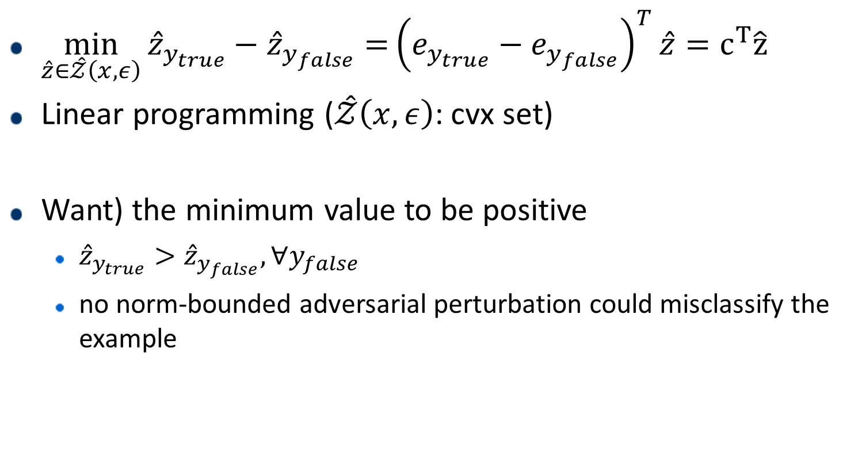
optimization formulation – inner min
$\min_{\hat{z}∈\hat{𝒵}\left(x,ε\right)}{{\hat{z}}_{y_{true}}−{\hat{z}}_{y_{false}}=}{\left(e_{y_{true}}−e_{y_{false}}\right)}^{T}\hat{z}=c^{T}\hat{z}$
Linear programming ($\hat{𝒵}\left(x,ε\right)$: cvx set)
Want) the minimum value to be positive
${\hat{z}}_{y_{true}}>{\hat{z}}_{y_{false}}, ∀y_{false}$
no norm-bounded adversarial perturbation could misclassify the example

Slide 25
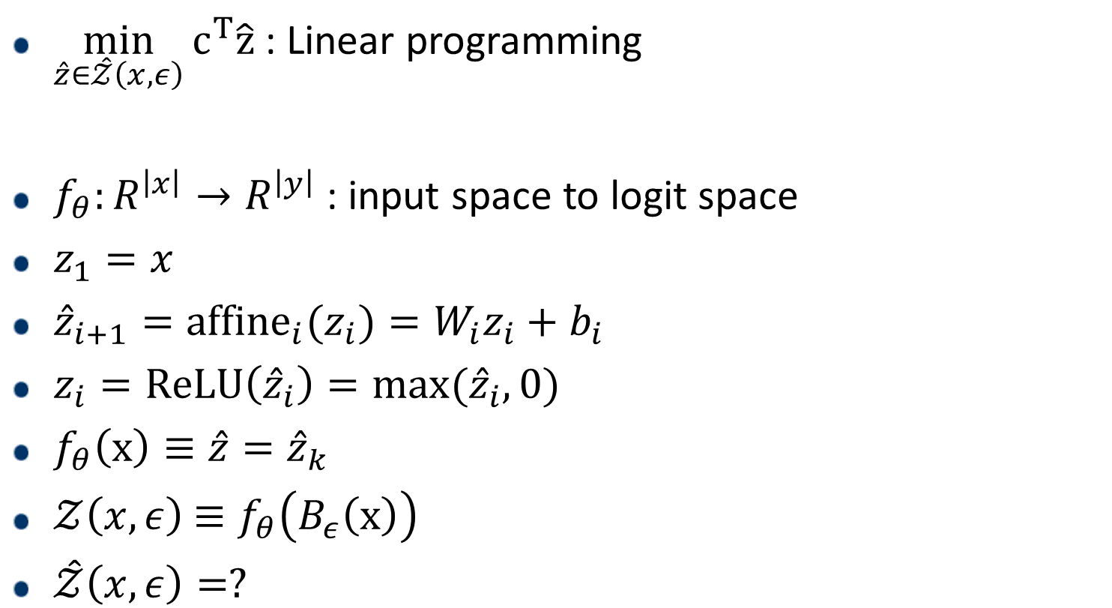
optimization formulation – inner LP
$\min_{\hat{z}∈\hat{𝒵}\left(x,ε\right)}{c^{T}\hat{z}}$ : Linear programming
$f_{θ}:R^{\left|x\right|}→R^{\left|y\right|}$ : input space to logit space
$z_{1}=x$
${\hat{z}}_{i+1}={affine}_{i}(z_{i})=W_{i}z_{i}+b_{i}$
$z_{i}=ReLU\left({\hat{z}}_{i}\right)=max⁡({\hat{z}}_{i},0)$
$f_{θ}\left(x\right)≡\hat{z}={\hat{z}}_{k}$
$𝒵\left(x,ε\right)$ $≡f_{θ}\left(B_{ε}\left(x\right)\right)$
$\hat{𝒵}\left(x,ε\right)=?$

Slide 26
optimization formulation – inner LP
$\min_{\hat{z}∈\hat{𝒵}\left(x,ε\right)}{c^{T}\hat{z}}$ : Linear programming
$f_{θ}:R^{\left|x\right|}→R^{\left|y\right|}$ : input space to logit space
$z_{1}=x$
${\hat{z}}_{i+1}={affine}_{i}(z_{i})=W_{i}z_{i}+b_{i}$
$z_{i}=ReLU\left({\hat{z}}_{i}\right)=max⁡({\hat{z}}_{i},0)$
$f_{θ}\left(x\right)≡\hat{z}={\hat{z}}_{k}$
$𝒵\left(x,ε\right)$ $≡f_{θ}\left(B_{ε}\left(x\right)\right)$
$\hat{𝒵}\left(x,ε\right)=?$

Slide 27

LP relaxation
$\min_{\hat{z}∈\hat{𝒵}\left(x,ε\right)}{c^{T}\hat{z}}$ : Linear programming
major issue
1) although the LP can be solved ‘efficiently’, actually solving an LP via traditional method for each example is not tractable
2) we need a way of computing the crucial $l$ and $u$

Slide 28

Dual feasible solution
$\min_{\hat{z}∈\hat{𝒵}\left(x,ε\right)}{c^{T}\hat{z}}$ : Linear programming
$\max_{0≤α≤1}{J_{ε}(x, g_{θ}\left(c, α\right))}$ : Dual

Slide 29
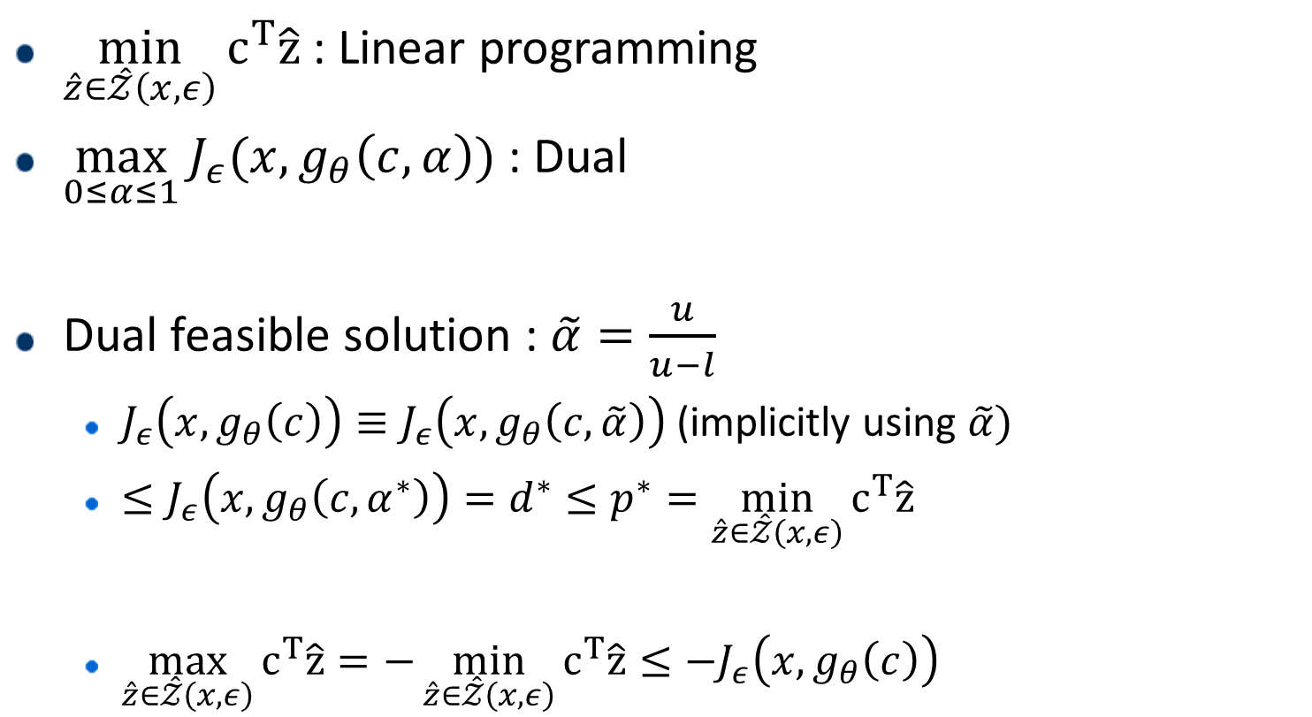
Dual feasible solution
$\min_{\hat{z}∈\hat{𝒵}\left(x,ε\right)}{c^{T}\hat{z}}$ : Linear programming
$\max_{0≤α≤1}{J_{ε}(x, g_{θ}\left(c, α\right))}$ : Dual
Dual feasible solution : $\tilde{α}=\frac{u}{u−l}$
$J_{ε}\left(x, g_{θ}\left(c\right)\right)≡J_{ε}\left(x, g_{θ}\left(c,\tilde{α}\right)\right)$ (implicitly using $\tilde{α}$)
$≤J_{ε}\left(x, g_{θ}\left(c, α^{∗}\right)\right)=d^{∗}≤p^{∗}=\min_{\hat{z}∈\hat{𝒵}\left(x,ε\right)}{c^{T}\hat{z}}$
$\max_{\hat{z}∈\hat{𝒵}\left(x,ε\right)}{c^{T}\hat{z}}=−\min_{\hat{z}∈\hat{𝒵}\left(x,ε\right)}{c^{T}\hat{z}}≤−J_{ε}\left(x, g_{θ}\left(c\right)\right)$

Slide 30

Dual feasible solution
Dual feasible solution : $\tilde{α}=\frac{u}{u−l}$
We choose$\tilde{α}=\frac{u}{u−l}$, because 1) $g_{θ}\left(c,\tilde{α}\right)$ is linear function of $c$ so that efficiently computed and 2) the lower bound provided by $\tilde{α}$ is tight enough

Slide 31
Computing 𝑙 and 𝑢

Slide 32
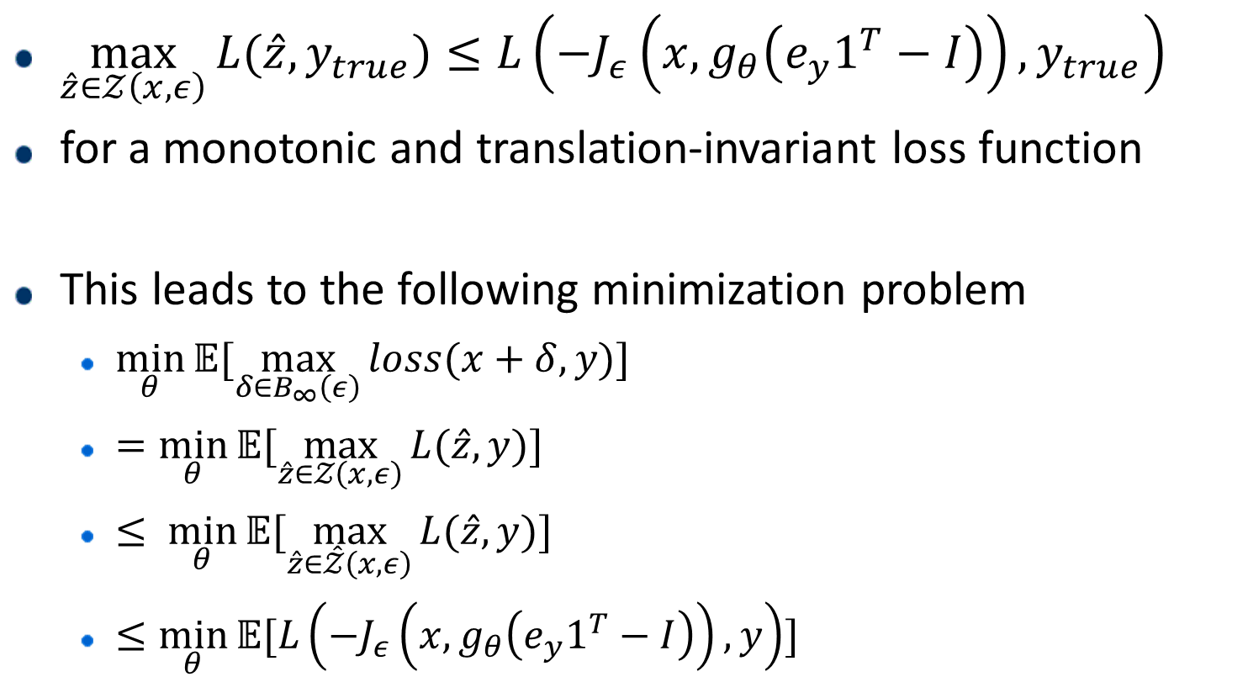
Theorem 2
$\max_{\hat{z}∈𝒵\left(x,ε\right)}{L(\hat{z}, y_{true})}≤L\left(−J_{ε}\left(x, g_{θ}\left(e_{y}1^{T}−I\right)\right),y_{true}\right)$
for a monotonic and translation-invariant loss function
This leads to the following minimization problem
$\min_{θ}{𝔼[\max_{δ∈B_{∞}\left(ε\right)}{loss(x+δ, y)}}]$
$=\min_{θ}{𝔼[\max_{\hat{z}∈𝒵\left(x,ε\right)}{L(\hat{z}, y)}}]$
$≤ \min_{θ}{𝔼[\max_{\hat{z}∈\hat{𝒵}\left(x,ε\right)}{L(\hat{z}, y)}}]$
$≤\min_{θ}{𝔼[L\left(−J_{ε}\left(x, g_{θ}\left(e_{y}1^{T}−I\right)\right),y\right)}]$

